Slide 1
Inclusive Vertical Communities
Belonging is having a home you can call your own.

Slide 2



Supported Living Goals
IMPROVE & OPTIMIZE
CONNECT
EXPAND
EXPAND
IMPROVE & OPTIMIZE
CONNECT
Notes:
Expand: Creating flow through our supported living continuum, increasing the range of housing & support options for individuals, including reducing shared bedrooms for adults and increasing our capacity to support more individuals waiting for a home to call their own.
Improve and Optimize: Utilizing experience and data available, planning redevelopment, renovations and repairs so our current housing stock meets the requirements for specialized complex care needs, now and into future.
Connect: Providing opportunity for reciprocal community networks and participation, giving a sense of belonging in a neighbourhood and more choice of where and with whom they live.

Slide 3

Real Estate and Program Development
Opportunities through partnerships with developers lead to new housing options, creating vacancies in existing homes, which provides us with circumstances for renewal, allowing the creation of new programs to increase capacity.
New affordable housing
New housing options
Creates vacancies in existing homes
Presents opportunity for renewal
Creates new programs and increases capacity

Slide 4
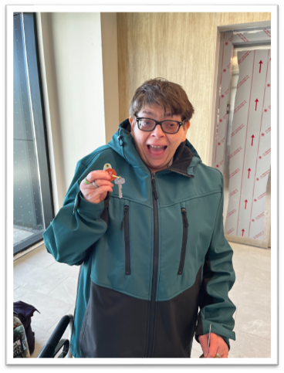
Inclusive Vertical Communities Overview
Shift from traditional group homes to inclusive vertical communities
  Community Inclusion
  Access to Amenities and Services
  Flexibility and Choice
  Increase in Independence
  Cost Effectiveness
  Reducing shared bedrooms

Slide 5
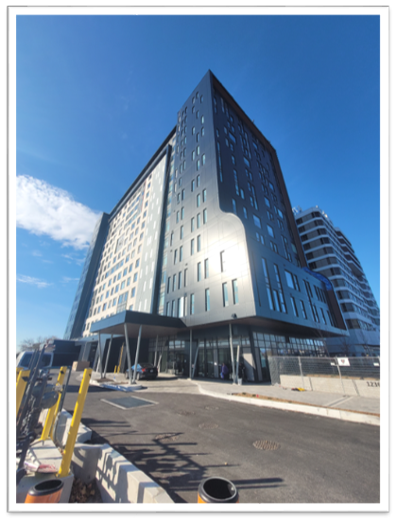
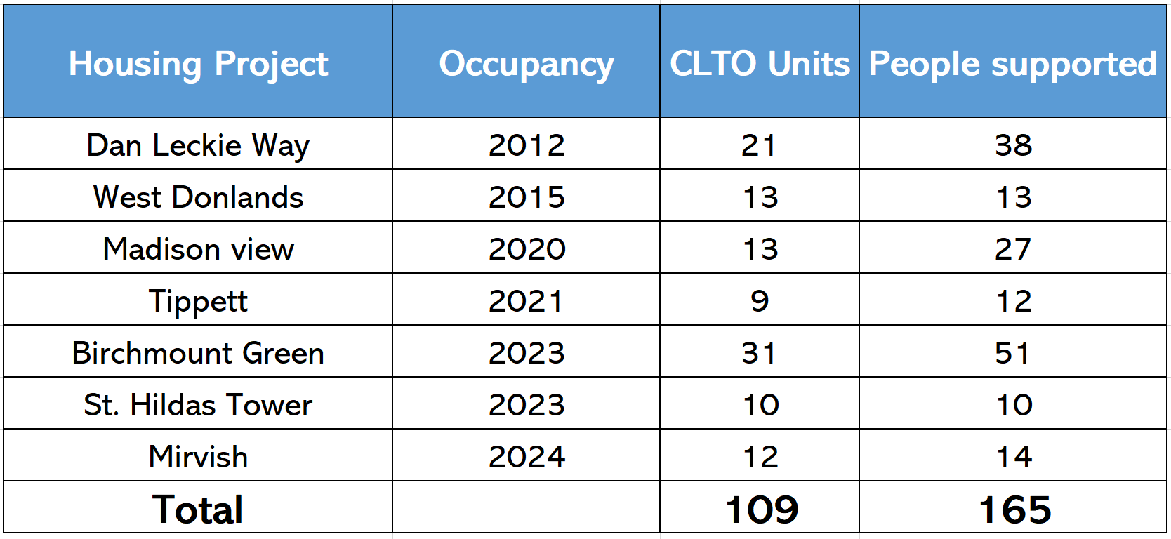
Inclusive Vertical Communities Summary

Slide 6




Partnership
Everything we do is built to enrich lives

Slide 7




Future Opportunities
Property Address​ | Developer/Owner​ | Total # of Units​ | Completion Expected​ | Affordable Units​ | # of Units for CLT​
777 Victoria Park Ave​ | Mahogany Management​ | 508​ | 2026/2027​ | 60​ | 11​
1240, 1246, 1250 Weston Rd (Quilt on Weston)​ | Learning Enrichment Foundation (LEF)​ | 71​ | 2026/2027​ | TBD​ | 20​
Golden Mile​ | Daniels Corporation​ | TBD​ | 2028/2029​ | TBD​ | 20​
3730 Kingston Road​ | TAS​ | 384​ | 2028/2029​ | 38​ | 10​
Total​ | ​ |  | ​ |  | 61​

Slide 8
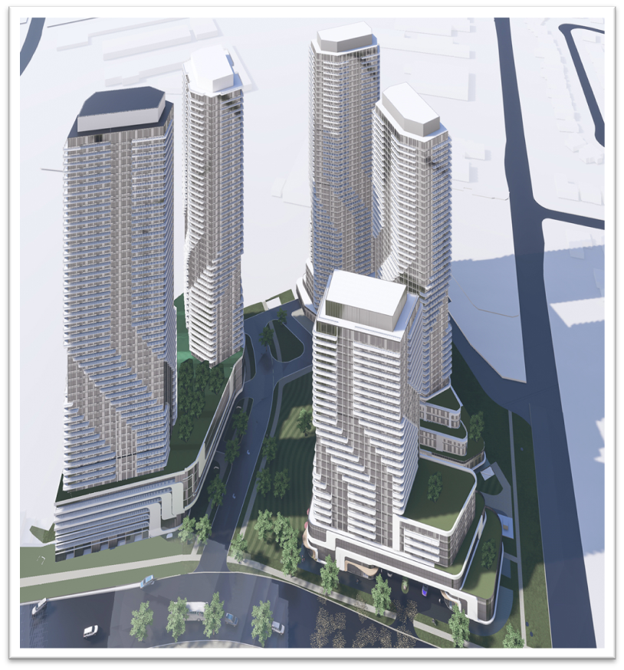
Lawson Redevelopment Project
  1710-12 Ellesmere Rd, Scarborough (Grangeway & Ellesmere)
5 towers, 28 – 52 storeys
  1 Rental building owned by CLTO
  4 Market Condominium buildings
Approx. 2,200 residential suites
  280 rental suites
  1,920 market condos
20% of Market Condos available to families and partner agencies
Approx. 20,000 sq. ft. of office and program space
New public road
On-site public park
Notes:
- Add a slide of Lawson (high level)

Slide 9
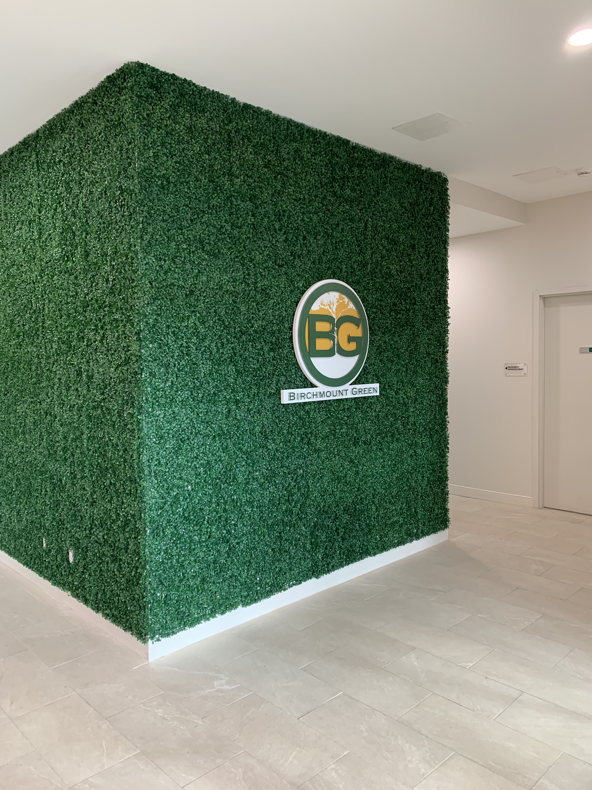
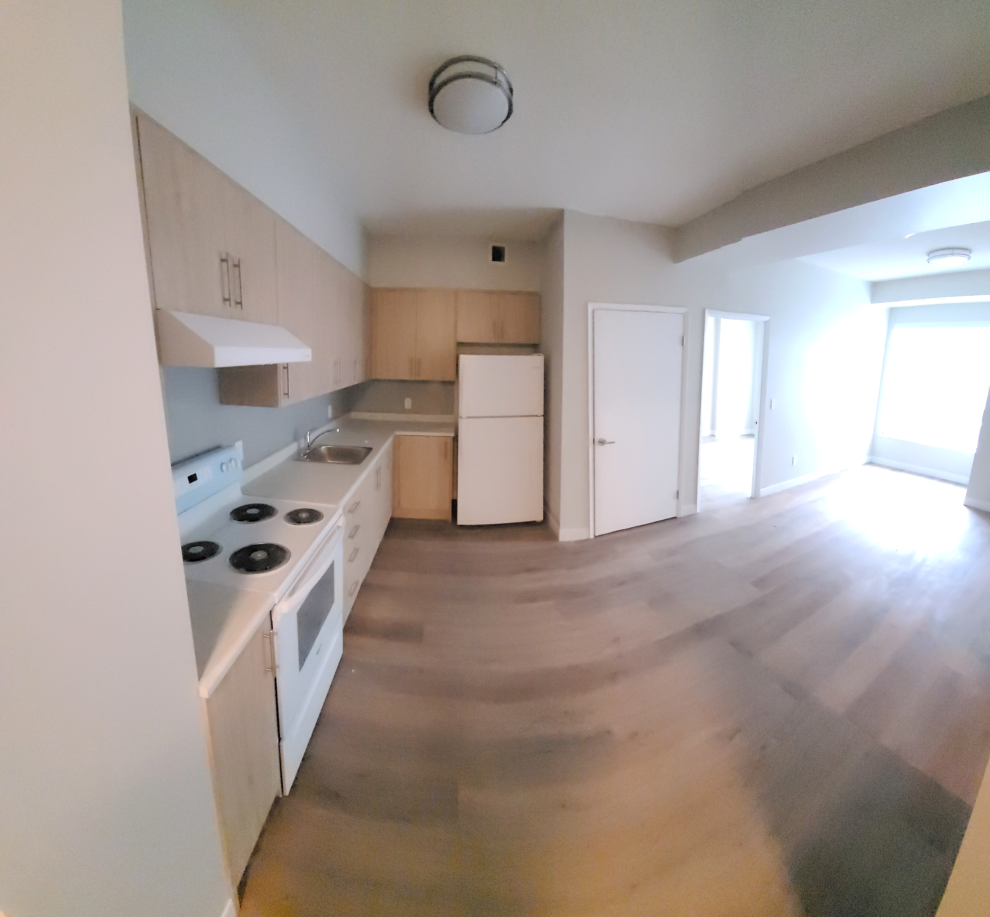
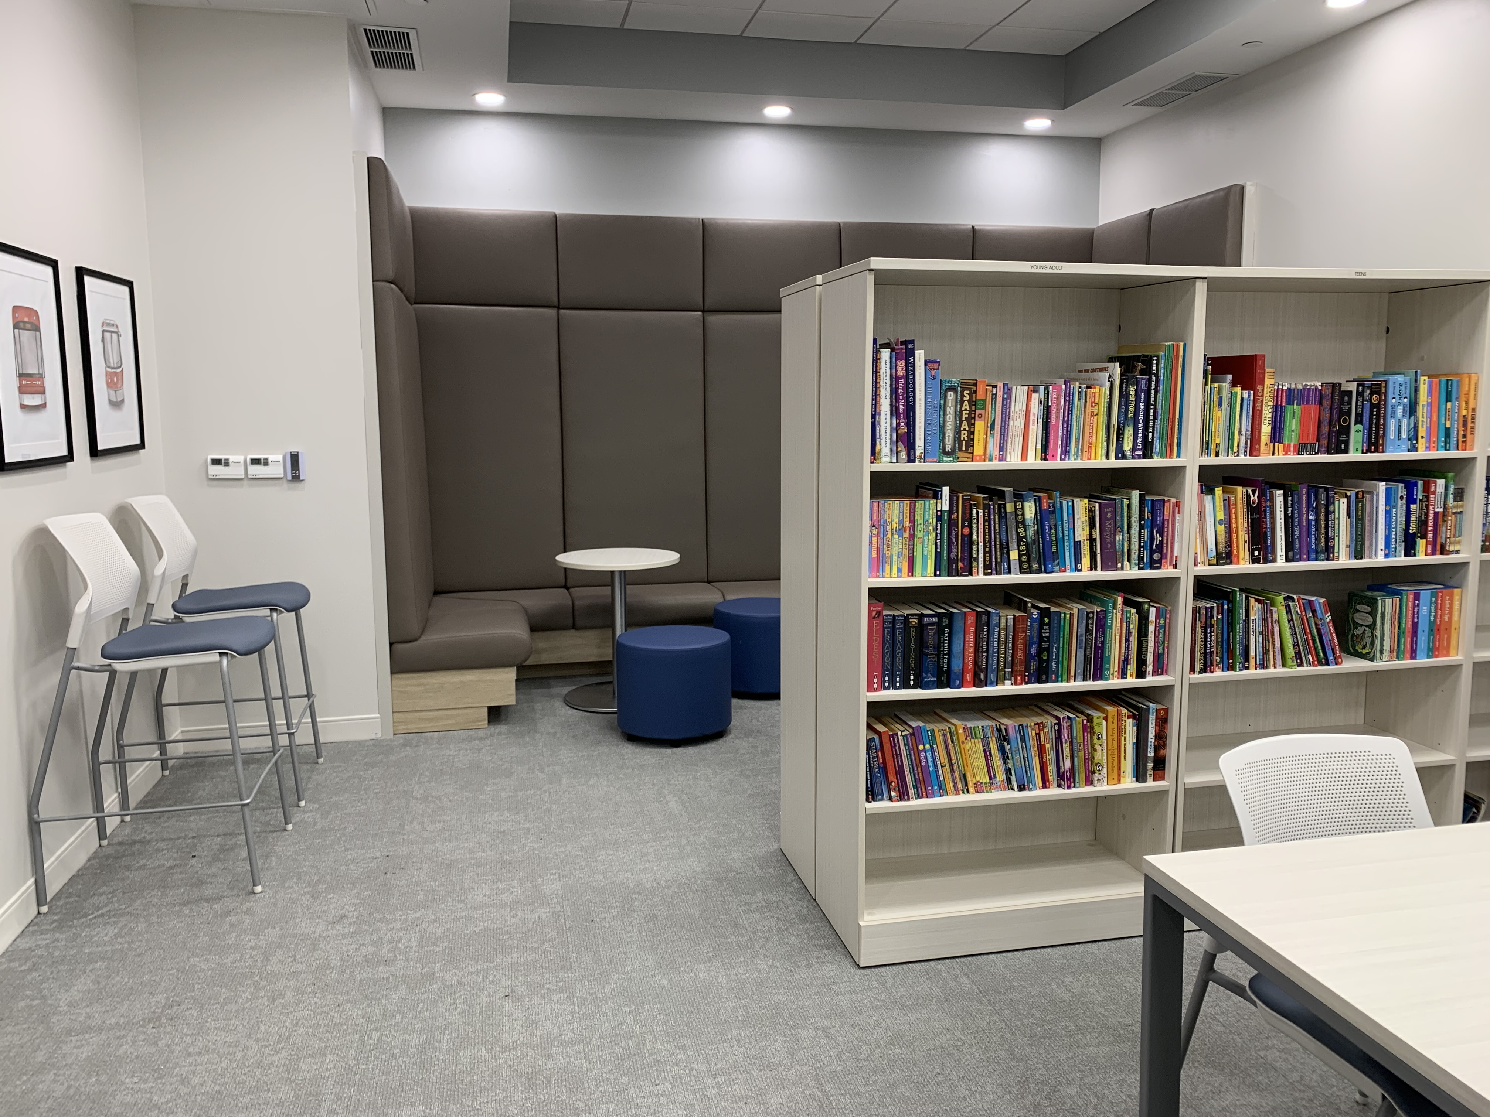
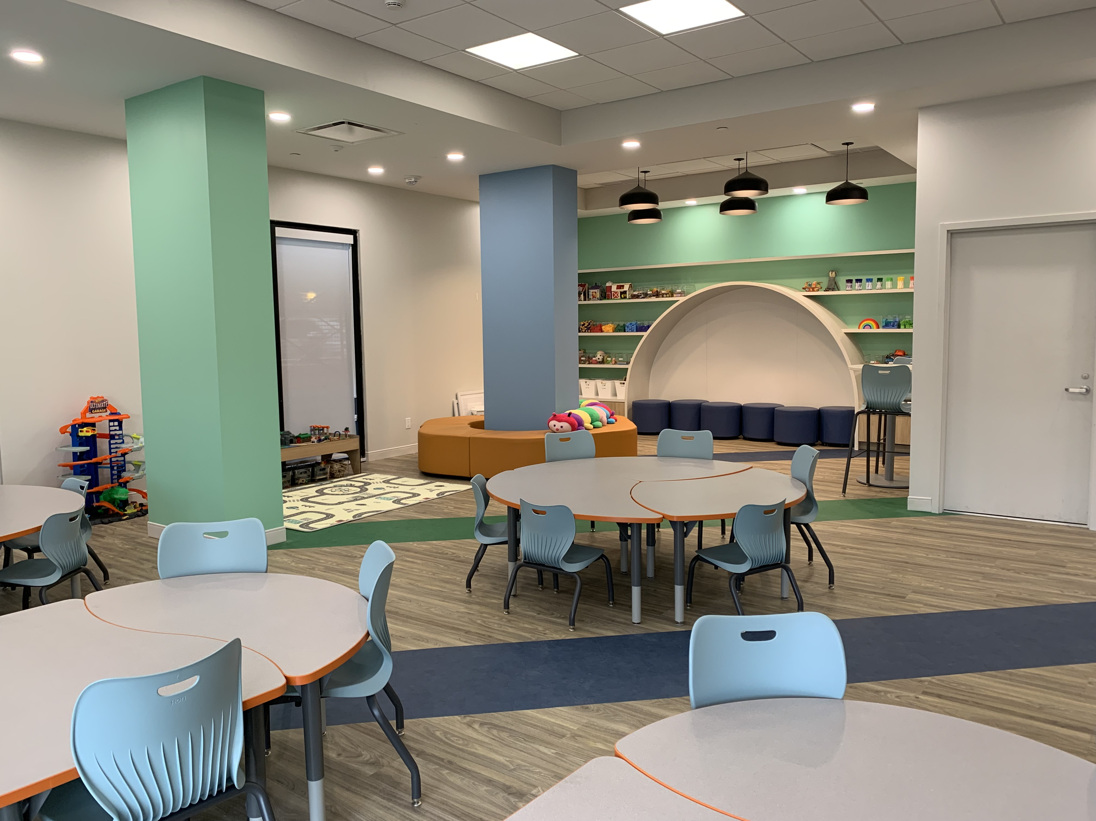
Example: Birchmount Green
1236 Birchmount Road
Location: Lawrence & Birchmount
15 Storey, 220 Units
31 affordable units for CLTO
Move-in fall 2023
Rent supplements
Street front retail component
  Social enterprise coffee shop
Developer: Mahogany Management
Able to take people from the DSO waiting list

Slide 10

Birchmount Green Video
Notes:
Video link: https://www.youtube.com/watch?v=HGg5AN7Sqew

Slide 11
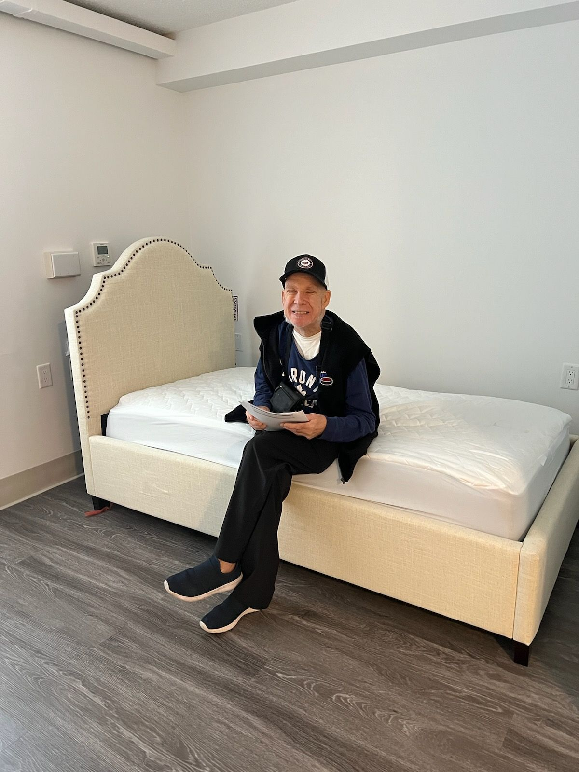
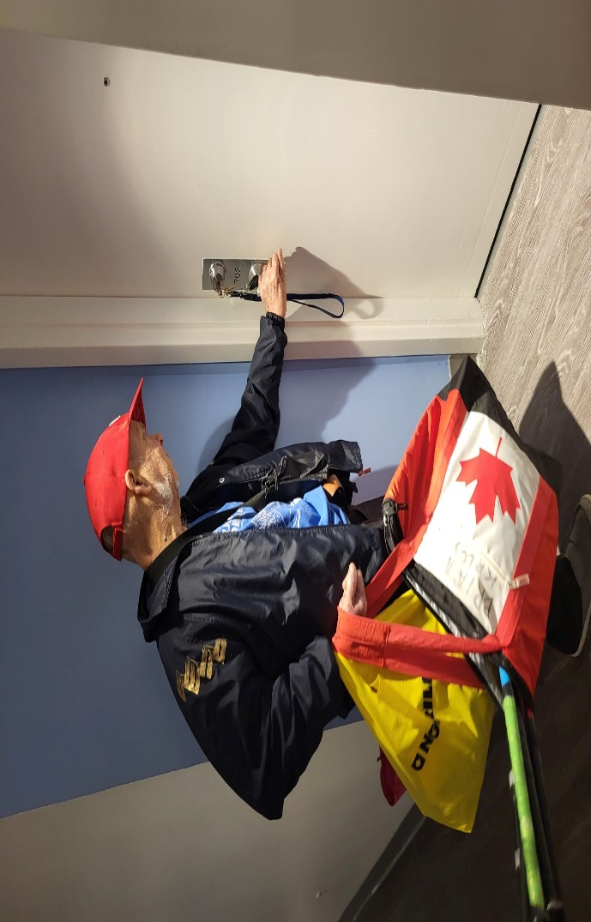
St. Hilda’s Tower – George’s Story
George has been supported in CLTO SIL Program for over two decades
George lost his long-time room-mate before the move to St Hilda’s but with the additional support of a vertical community has thrived
He enjoys exploring new shops, restaurants and attends a new church where he’s made new friendships
Actively involved in the daily activities that are offered including card games, and dinners
Notes:
George’s journey to his new home at St. Hildas was one of excitement, joy, and a fresh start. George has been supported in Community Living Torontos Supported Independent Living program for over two decades. He has spent this time living with his long-time roommate in a shared apartment in downtown Toronto. The two planned to move to St. Hildas together living on the same floor but in separate units. Unfortunately, his roommate passed away unexpectedly shortly before they were to move in. As George grieved the loss of his best friend, he begun his own personal journey of living in a new apartment and neighbourhood. It’s been a wonderful experience for George as he has found a sense of belonging in his new building and neighbourhood. He enjoys exploring the different shops, restaurants, community and attends a new church where he’s made new friendships. He has made many new connections in the building and is actively involved in their daily activities that are offered. Geroge has expressed how happy and lucky he is at his new place and it that it feels like home.

Slide 12


