Slide 1

CMHC
Housing
Solutions
CMHC.ca

Slide 2

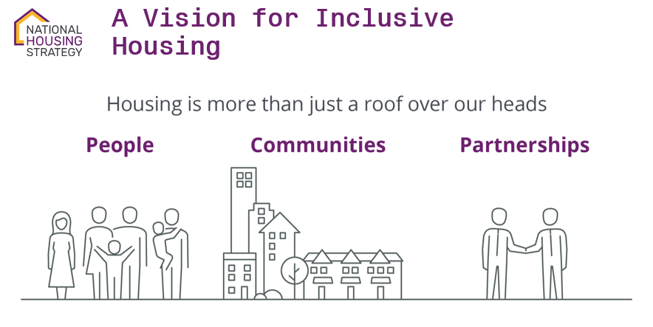
National Housing Strategy
Notes:
People
The Strategy will better meet the needs of Canadians with distinct housing needs. Seniors, veterans, women and their children, etc. Groups that for whatever reason face barriers to achieving housing security.
Communities
The NHS is creating a new generation of housing. Housing that promotes diversity and inclusion, and is a catalyst for more complete communities.
Housing investments align with other public investments including climate action, proximity to public transit and essential services.
Partnerships
The NHS is creating opportunities for greater innovation and collaboration among all levels of government, non-profit and co-operative housing providers, the private sector, and academia to make a meaningful difference in the lives of Canadians. – We can’t do this alone.
Federal, provincial and territorial governments are primary partners in housing.

Slide 3
Financial incentives to drive social outcomes
Social Outcomes | Incentives
Affordability
Energy Efficiency
Accessibility
Proximity to Amenities
Partnerships
Lower interest rates
Low equity requirement
Longer amortization
Lower Debt Coverage Ratio
Longer loan terms
Canada Mortgage and Housing Corporation
Notes:
How do we actualize the social outcome priorities of the NHS
How do we deliver on (List)
We have financing incentives (List) to ensure project viability

Slide 4






Housing Accelerator Fund
Implementation of initiatives to get more homes built faster |  | Speed up approvals and building processes |  | Development of complete communities |  | Development of affordable, inclusive, equitable and diverse communities |  | Development of low-carbon and climate-resilient communities.

Slide 5
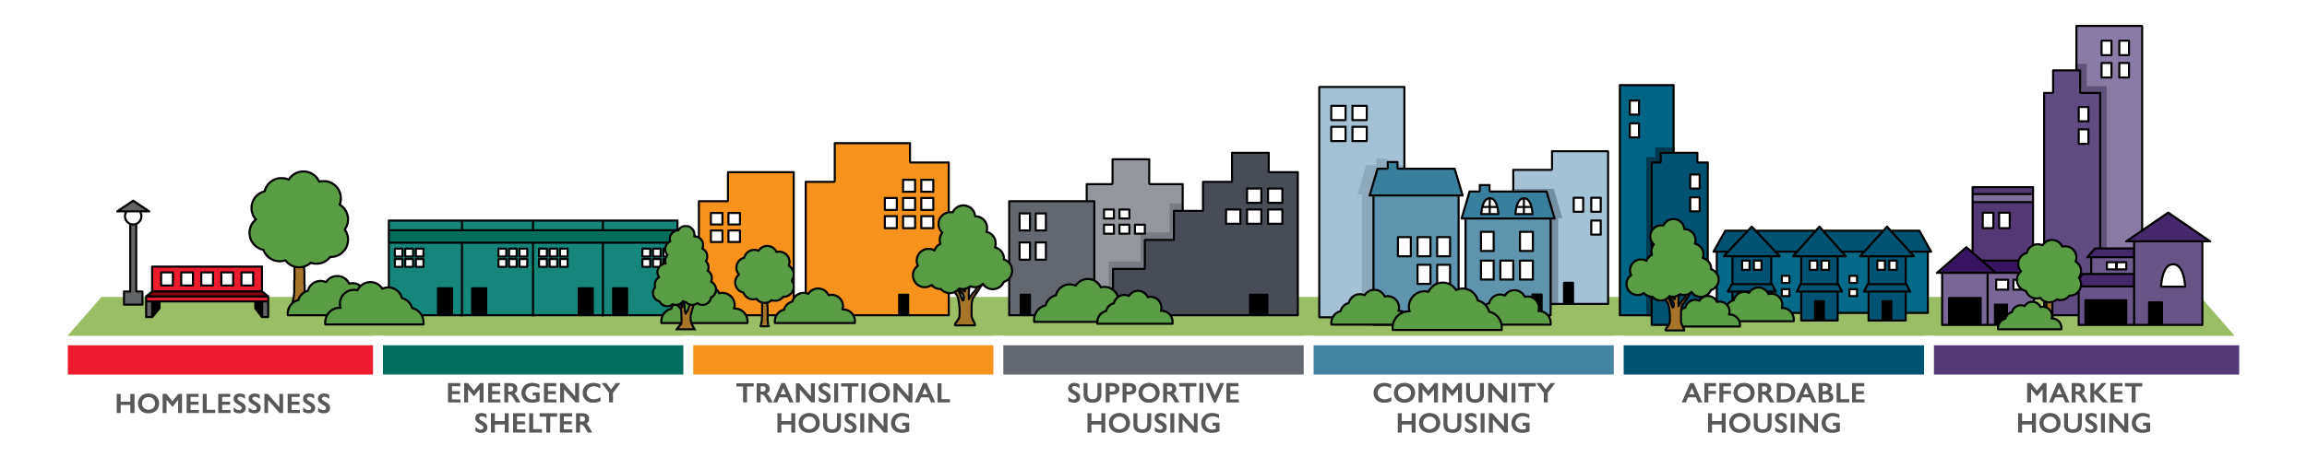
National Housing Strategy
Build new affordable housing
Renew & repair existing affordable housing
Support social housing providers
Research & Innovation

Slide 6
CMHC Solutions along the Housing Continuum
MLI Select
MLI
Apartment Construction Loan Prog.
Affordable Housing Fund
Seed Funding
Notes:
CMHC offers a wide array of housing solutions
This shows these solutions and roughly where each fits on the housing affordability continuum
Today I’ll talk briefly about these

Slide 7
Project types and CMHC product offerings
 | Programs/Initiatives |  | Products
Project Type | Seed Funding | Apartment Construction Loan Program | MLI Select | MLI for market rental
 | Affordable Housing Fund
 | Canada Greener Affordable Housing
Standard apartment | ✓ | ✓ | ✓ | ✓
Student housing |  |  |  | ✓
Single room occupancy (SRO) housing | ✓ |  | ✓ | ✓
Retirement housing (basic & assisted needs) | ✓ |  | ✓ | ✓
Supportive housing | ✓ |  | ✓ | ✓
7
Notes:
Two major categories left programs initiatives under the national housing strategy, the strategy was launched in 2018 and CMHC was given the mandate of coordinating the funding.
on the right we have our more traditional mortgage insurance products.
products and programs that span all housing types, however, some have a particular focus.

Slide 8
Phases of development and CMHC product offerings
PHASES OF DEVELOPMENT
 | Pre-development | Construction | Rent up/stabilization
Affordable Housing Solutions | Seed Funding (for soft costs)
 | Affordable Housing Fund
 |  | Apartment Construction Loan Program
Commercial Products |  | MLI Select
Commercial Products |  | Mortgage Loan Insurance for multi-unit rental properties
8
Notes:
We have a range of initiatives that span the full housing development process, from pre-development to project stabilization. In some cases, the program is designed to address the pre-development phase and assist with soft-costs as is the case with the Seed Funding program. Other programs can also span from the pre-development phase all the way through the rent up/stabilization phase.

Slide 9







Criteria and Priorities
Intended residents
(serving a priority population)
5+ affordable units or beds
5+
$
Financially viable
Affordability: degree & duration
Energy efficiency & GHGs
Access to transit & amenities
Accessibility features
Partnerships
Notes:
All of our programs (in the general sense), follow this prioritization criteria
support populations that are at need
Must include a depth and duration of affordability
Access to amenities
Have Accessibility features
And support Energy efficiency goals.
Partnerships are a central feature of the NHS. Most of our programs require that Federal funding must be supplemented by investments from another source/partner, such as another level of government to ensure coordination of investments.
For our direct lending programs, we also have requirements in terms of experience, so we need applicants to demonstrate 5 years of property management exp , and 5 years of exp in relevant construction exp. And 3 years of audited financial statements.

Slide 10

Priority Groups
The NHS prioritizes projects that target:
Women and children fleeing domestic violence
Seniors
Young adults
Indigenous peoples
People with disabilities
People dealing with mental health and addiction issues
Veterans
LGBTQ2+
Racialized groups
Recent immigrants, especially refugees
People experiencing homelessness
Canada Mortgage and Housing Corporation
Notes:
The priorities of people communities and partnerships.
The NHS is about people first, so we have priority groups that have been identified. This is an important part to developing an equity framework to ensure that the social outcomes were looking for can reach down into the communities.

Slide 11
Seed Funding
Assistance for financing preliminary activities of a housing project

Slide 12
Overview
New construction/repair stream
a contribution of up to $150K and/or
an interest-free loan of up to $350K
Non-repayable contributions
and/or
Interest-free loans
12
Notes:
Seed Funding can provide non-repayable contributions and/or interest-free loans to assist with the planning costs of building a new affordable housing project. It can also provide contributions to help preserve existing community housing projects so that they remain viable and sustainable.
Maximum contribution:
For co-operatives, non-profits, Indigenous groups—up to 40% of the total approved funding, to a maximum of $150,000 (whichever is less)
Maximum loan:
Up to $350,000 (security to be provided where required)

Slide 13
SEED Update Q1 2024
Stage 1:
Concept development/pre-design
New Funding Approach
through
Stage 2:
Schematic development
3 Funding Stages
Portal is open as of March 1st, 2024
Stage 3:
Design development
13

Slide 14
SEED - 3 Stages of Funding
Stage 1:
Concept development/pre-design
The land is determined, but not acquired, and soil or environmental considerations are unknown.
No funding partner has been identified.
The proponent has no designs for the suggested project.
Stage 2:
Schematic development
The land is now owned by the proponent, but there is still work to be done (e.g., environmental site assessment and zoning).
Sources of funding have been determined, with a few letters of agreement.
Conceptual and preliminary plans have been obtained.
Stage 3:
Design development
The land is owned by the proponent, has been evaluated and is suitable for the project.
The majority of funding sources have been confirmed.
The proponent has plans and designs for the project and is almost at the tendering process.
14

Slide 15

Eligible Activities
Please note: Not all listed activities are required for submission. Needs will vary by project/program.
Needs & Demand Analysis
Business Plan
Incorporation
Preliminary Financial Feasibility Analysis
Option to Purchase
Special Purpose Surveys
Environmental Site Assessments
Geotechnical Reports
Accessibility Modeling Analysis
Energy Efficiency Modeling Analysis
Development Fees
Preliminary Design
Professional Assessment
Viability study of the project
Security Registration
Site Assessments
Evaluation of the completion of the work
Estimating construction costs
Contract documents
Development Permit
Engineering Studies
Final Report on Financial Sustainability
Plans and specifications of the whole
Quantity Surveyor
Canada Mortgage and Housing Corporation

Slide 16
Affordable Housing Fund
*Formerly the National Housing
Co-Investment Fund
Low-cost repayable loans and/or forgivable loans or contributions to build new affordable housing and repair/renew existing affordable and community housing.
Notes:
This is our flagship program which offers low-cost repayable loans, with potential loan forgiveness. We also offer grants for repair/renewal of affordable units. It is biased towards the community housing sector, when compared to other eligible applicants, as we will see.
Again, I want to start out by addressing changes that have occurred in the last year with the Co-Investment program before we get into the program overview.
First, the contribution only stream for new construction has closed. It was open from May 2022 to December 2022 and during that time we had tremendous uptake. 46 new projects were funded.
The contribution only stream is still open for repair and renewal projects. So that remains an option, which we will see.
In terms of the forgivable loan portion of the repayable loan stream, these have been capped at up to 25k per unit or up to 10% of total project costs. I would emphasize the UP TO here because that will be the subject of discussion with the underwriting team and will be decided on a case-by-case basis.
There has also been a change in application requirements for Co-I. So we are now asking applicants to provide class B financials with their application. While we understand this is more expensive to provide, This increased level of accuracy in cost estimates has been deemed necessary to reduce uncertainty in the project evaluation process.

Slide 17
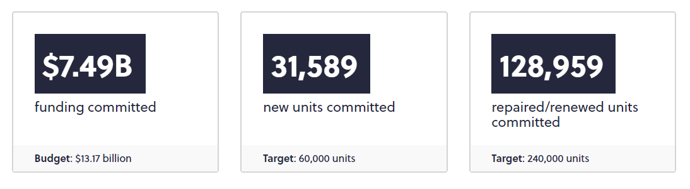
Affordable Housing Fund
Progress Report September 2023
Fall Economic Statement, November 2023: Additional $1 Billion allocated, starting in 2025-26
Notes:
Ill talk more about financial viability on the next slide.
So we provide the benefits I mentioned on the last slide, and in exchange we are looking for commitments to social outcomes. READ SLIDE
Borrowers must demonstrate an affordability commitment for a minimum of 20 years.
Applications will also be scored on additional criteria aligned with Government priorities and linked to social outcomes. If the project goes above and beyond these requirements, there is also potential for loan forgiveness to compensate for exceeding these social outcomes. That is determined based on need and how the application is scored. You get more points for deeper affordability, or better energy efficiency, for example.

Slide 18
Overview
New
Construction
Revitalization
Develop new, high-performing affordable housing, near necessary supports and amenities, public transit, jobs, daycares, schools, healthcare
Minimum investment of $1,000,000 (repayable loan and forgivable loan)
Preservation and revitalization of the existing community and affordable housing
Minimum investment of $250,000 (repayable loan and forgivable loan)
18
Notes:
What are the benefits of applying for the co-investment fund?

Slide 19

Eligibility
Groups
Projects
Community housing providers (public,
private, non-profit,
rental, co-op)
Municipalities, provinces
& territories
Indigenous governing bodies and organizations
Private sector
Urban Indigenous
community housing
Mixed-use market and/or affordable rental housing
New construction
and/or conversion from a non-residential use to affordable multi-unit housing
Shelters
Transitional and supportive housing
19
Notes:
The National Housing Co-Investment Fund – is open to:
community housing providers (such as public or private non-profit housing organizations or rental co-operatives)
And projects eligible

Slide 20
Financial Incentives
Affordable Housing Program
Low Interest Loan*
LTC up to 95% (75% non-residential) †
Amortization up to 50 years
Debt coverage ratio 1.0 (1.4 non-residential)
*10-year term and fixed interest rate, renewable another 10 years
† Non-residential aspect up to 30% of project costs and area
Forgivable Loan : $25k per unit more may be considered if projects exceed targeted criteria
Notes:
Term of 10 years (no prepayment option) and fixed interest rate set at first advance. Repayable loans will be renewable for a term of 10 years and the interest rate will be adjusted at renewal.
Loans up to 95% of costs for residential spaces and 75% for non-residential spaces. Loans for residential spaces up to 75% of costs for municipalities, provinces, territories and the private sector.Can also do non-residential, so ground floor commercial, or institutional would work.
Up to 50 years repayable loan amortization. for lower monthly mortgage payments and long-term viability.
Interest-only payments financed by the repayable loan during construction through to occupancy permit and interest-only payments paid by the borrower from occupancy permit to 12 months of stabilization.
40 years for repair and renewal stream
Interest-only payments until completion of repairs

Slide 21
Social Outcomes
Minimum eligibility requirements
$
Affordability
30% of units
@ 80% Median Market Rent (MMR)
Energy consumption & GHG emissions
Exceed the 2015 NECB or NBC by 25%
Accessibility
20% of units (common areas barrier-free) OR 100% universal design
Borrowers must demonstrate an affordability commitment for
a minimum of 20 years from first occupancy under the CMHC Loan
Notes:
Ill talk more about financial viability on the next slide.
So we provide the benefits I mentioned on the last slide, and in exchange we are looking for commitments to social outcomes. READ SLIDE
Borrowers must demonstrate an affordability commitment for a minimum of 20 years.
Applications will also be scored on additional criteria aligned with Government priorities and linked to social outcomes. If the project goes above and beyond these requirements, there is also potential for loan forgiveness to compensate for exceeding these social outcomes. That is determined based on need and how the application is scored. You get more points for deeper affordability, or better energy efficiency, for example.

Slide 22
Social Outcomes
Additional
NEW!
$
$
$
Standard
up to 25k per unit forgivable loan
Affordability+
Min 40% units <70% MMR
additional 25k per unit
Energy Efficiency+
>35% EE & GHG reduction
additional 25k per unit
Forgivable loan amounts represent the max available and are offered based on need to achieve financial viability

Slide 23
Partnerships
Minimum eligibility requirements
To make federal investments go further, applicants to the Affordable Housing Fund must have additional sources
of funding
Projects must have support from another level of government and can be in the form of investment of resources and/or the form of a letter of endorsement
Contributions from collaborators can be monetary or in-kind
Notes:
Called the Co-Investment fund which implies that other investors would be involved.
Partnerships are a central feature of the National Housing Co-Investment Fund. Federal funding must be supplemented by investments from another level of government (such as municipalities, Provinces and/or Territories) to ensure coordination of investments.
Partnerships are key:
We are looking to spread out this money to get as many projects funded as possible, so applicants must have additional sources of funding.
Support from another level of government can be in the form of investment of resources and/or the form of a letter of endorsement.
Contributions from collaborators can be monetary or in-kind, speeding up permits approvals at the municipal level for example.

Slide 24

Prioritization of social outcomes
In addition to meeting mandatory minimum requirements, the Fund will prioritize projects with higher scores based on the achievement of outcomes within the following priority areas:
Affordability
Greater number of units,
and depth of affordability
Energy Efficiency
Greater than 25% energy efficiency improvement & GHG emission reduction
Accessibility
Greater number of accessible units and level of accessibility provided
Social Inclusion
Integrated supports and
services for tenants on site
24
Notes:
Read slide;
Good moment to pause to let you know that there are flexibilities in this program. We wouldn’t want you to look at these slides and come away with the impression that we wont look at your project and try to help make it work.
Specifically for the repair and renewal stream. We understand that some buildings will not be able to achieve a 25% energy efficiency improvement. Or perhaps the design will not be able to meet our accessibility requirements. If you have affordable units that need repairs, we can work with you to ensure we are not losing affordable units.

Slide 25
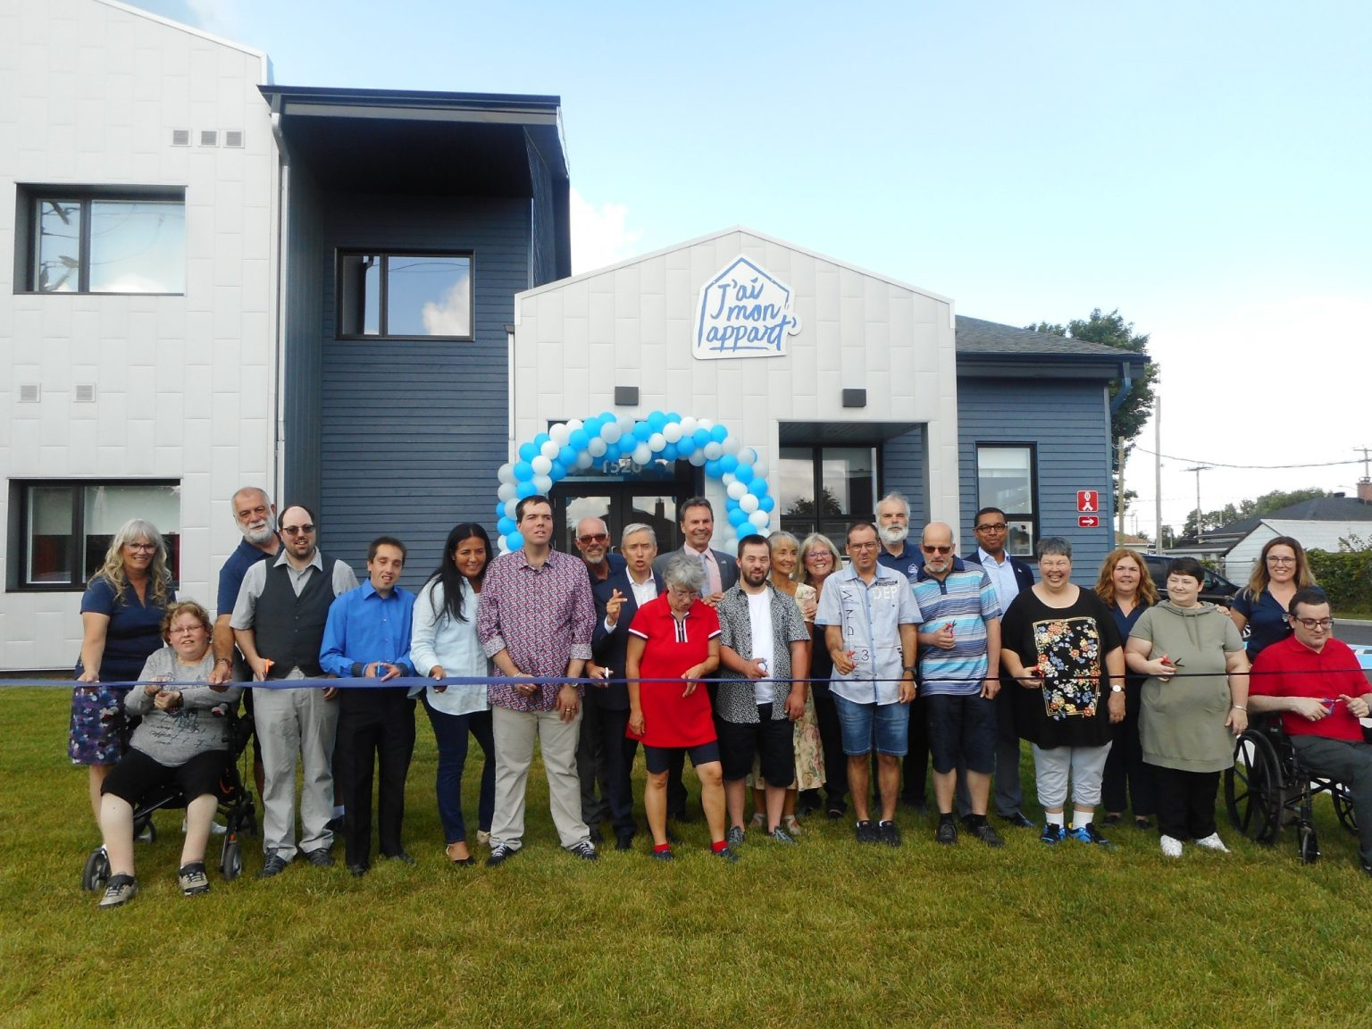
Announced Projects
J’ai mon appart
Shawinigan, QC
12 affordable units
$48,000 Seed Funding
$850,000 AHF
$1.5M AccèsLogis (Québec) & City of Shawinigan
+26.3% Energy Efficiency & GHG
6 accessible units
Photo credit: l’Hebdo du St-Maurice

Slide 26
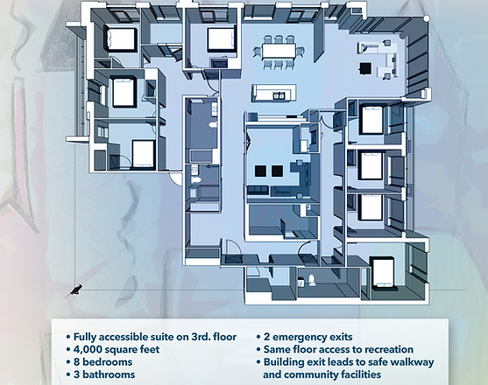
Announced Projects
L’Arche Toronto​
Regent Park
Toronto, ON
8 affordable units
5 core members + 3 direct support workers
Single floor in new condo
$800,000 AHF
$457,000 cash equity
$1.7M Everyone Belongs capital campaign

Slide 27

Research & Innovation

Slide 28

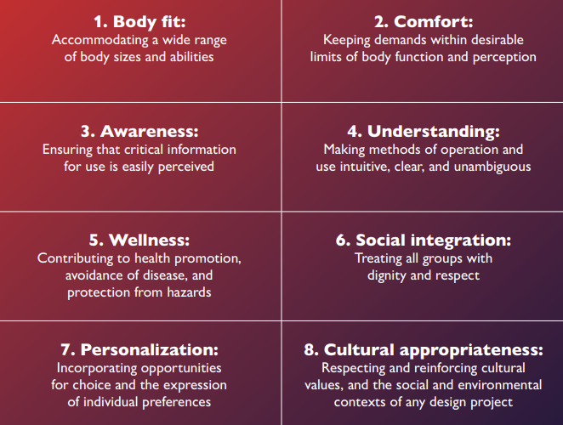
Universal Design Guide
The goal of Universal Design
Canada Mortgage and Housing Corporation
Notes:
The priorities of people communities and partnerships.
The NHS is about people first, so we have priority groups that have been identified. This is an important part to developing an equity framework to ensure that the social outcomes were looking for can reach down into the communities.

Slide 29
Expert Community on Housing
(ECoH)
A diverse, collaborative community working together to scale housing solutions. Our network includes leaders and collaborators from both inside and outside the housing sector.

Slide 30



Expert Community on Housing
ECoH is an open community where members
with a wide range of housing experience can collaborate, share knowledge, contribute to
the development of housing solutions, and network with leaders within and outside of
the traditional housing ecosystem to address common challenges. Visit CMHC.ca/ECoH today!
Webinar Series
Task Teams & Discussions
Community Events
Notes:
LEAH

Slide 31





Task Teams
Examples of Task Teams on ECoH:
Alternative and disruptive housing models
Members can form a Task Team on Microsoft, which is a channel dedicated to supporting a specific impact project, region or area of practice.
The ECoH team helps to set up the hub and supports the leader with programming that will help move the community towards its goals.
CLTs and Land Assembly Solutions
Research Open House
Innovation Space
Atlantic Community of Practice
Notes:
LEAH
High-level description of the CoP function

Slide 32
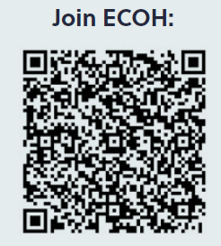
Join ECoH!
Notes:
IF YOU AREN'T YET ON THE PLATFORM --
For those of you not on ECoH.
1. Register to the ECOH platform and opt in to the Community of Practice here.
Put link in chat.
...
If you are on the platform and have not yet been added to the CoP, please put your name in the chat.

Slide 33
20211006-003
For questions and more information
jtessier@cmhc-schl.gc.ca
Thank you!
CMHC.ca

